Slide 1
LFT Mockup Review

Slide 2
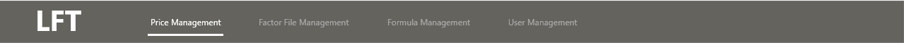
Content
1
2
3
4
5
6
Manage
Factor File
Maintain Formula
Fill in Excel offline
Upload Excel
Calculate result
Customize
Table
User behavior shapes LFT navigation

Slide 3
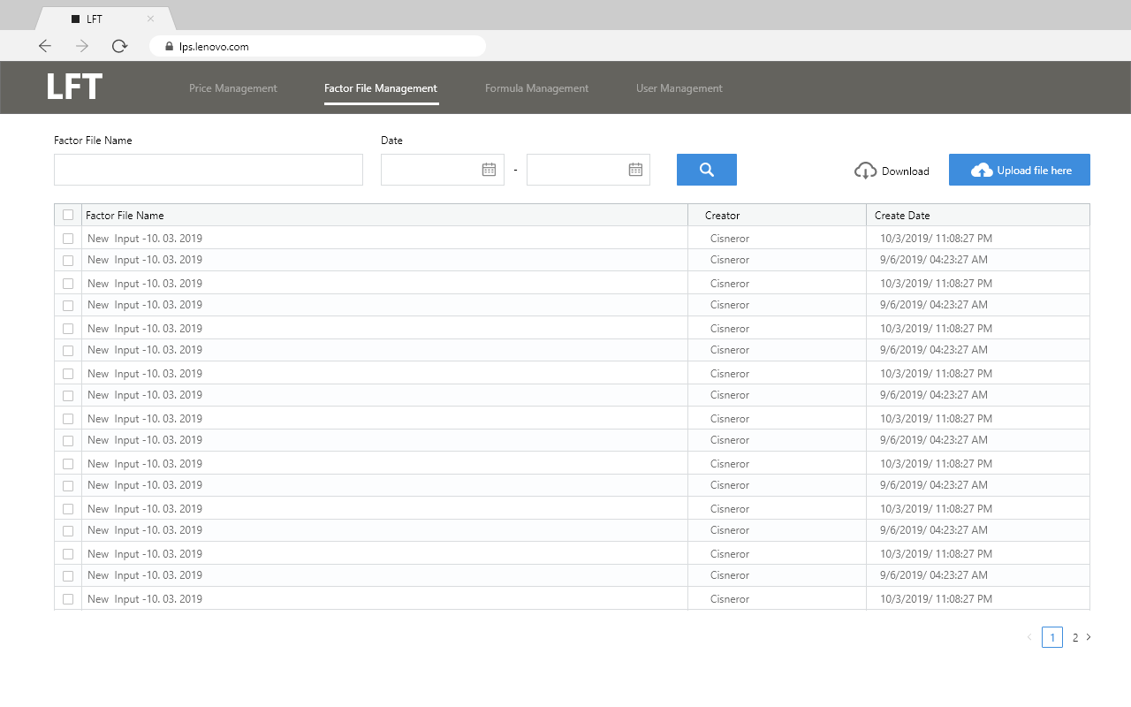
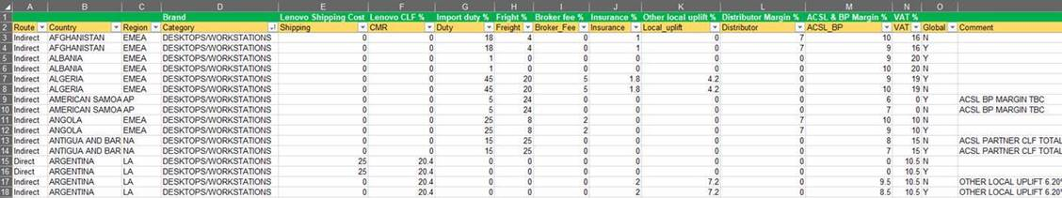
1. Factor File Management
The factor file is maintained by Admin User.

Slide 4
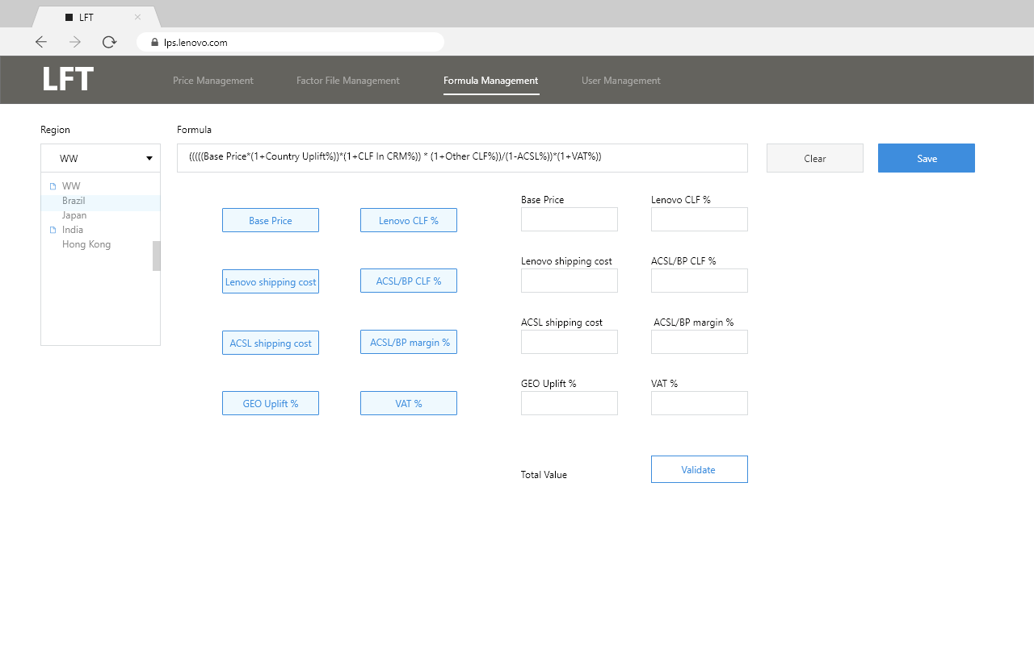
2. Maintain Formula
Switch to different region
Maintain different formula for different Geos
Customize items

Slide 5
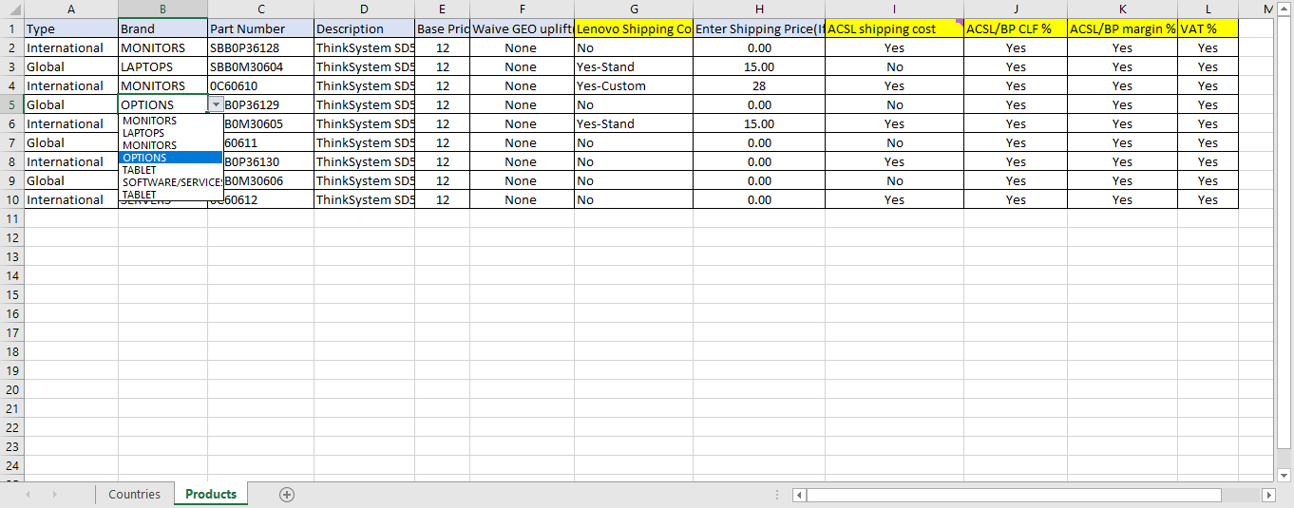
3. Fill in Excel offline
10
ACSL/BP CLF %
If YES, then the value in the formula is equal to sum of the values (Import duty %+freight %+broker fee %+insurance %+other local uplifts %+and distributor %) in Factor file
If NO, then the value in the formula is equal to 0.00联想航运成本
“否”- H栏，填上“0.00”;
“自定义”-列H与数值;
“标准”-列H值根据brandACSL/BP CLF %
如果是，则公式中的值等于因子文件中的值之和(进口税%+运费%+经纪人费%+保险%+其他本地提升%+和分销商%)
如果没有，则公式中的值等于0.00
Input the data based on the Excel template instead of adding them one by one
1
Type
Restricted Global or International
受限制的全球或国际
3
Part Number
Free text, no restrictions
Base price
numeric only
5
7
Lenovo shipping cost
“No”–Column H with “0.00”;
“Custom”–Column H with Numerical values;
“Standard”–Column H with values according to the brand联想航运成本
“否”- H栏，填上“0.00”;
“自定义”-列H与数值;
“标准”-列H值根据品牌
12
ACSL/BP CLF%,
ACSL/BP margin%
VAT
Restricted to YES or NO
增值税
仅限于是或不是
1
Brand Restricted to list of product family
Description
Free text, no restrictions
Waive GEO uplift
The only options: waive AP only, Brazil only, both, or none (4 alternatives) – Default choice: None
ACSL Shipping cost
Restricted to YES or NO
Pending to review internally with the team
ACSL航运成本
仅限于是或不是
等待与团队进行内部审查
ACSL/BP margin %
If YES, then the value in the formula is equal to the values ACSL & BP MARGIN %) in Factor file
If NO, then the value in the formula is equal to 0.00
ACSL /英国石油公司利润%
如果是，则公式中的值等于因子文件中的ACSL和BP MARGIN %)的值
如果没有，则公式中的值等于0.00
4
6
9
11

Slide 6
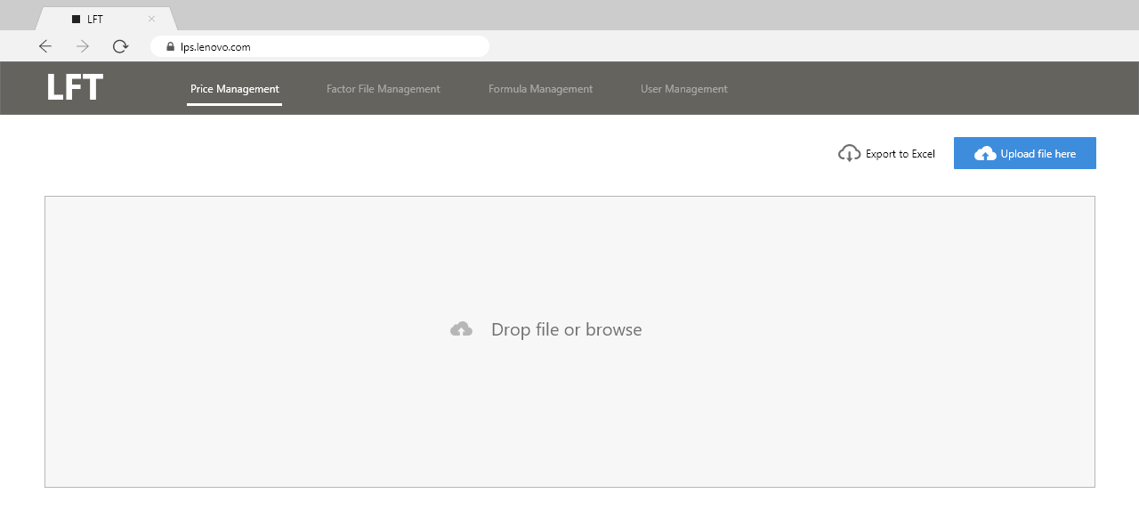
4. Upload Excel
Upload the excel to LFT under Price Management Tab.
Click the Upload button
Or drag Excel to the box directly

Slide 7
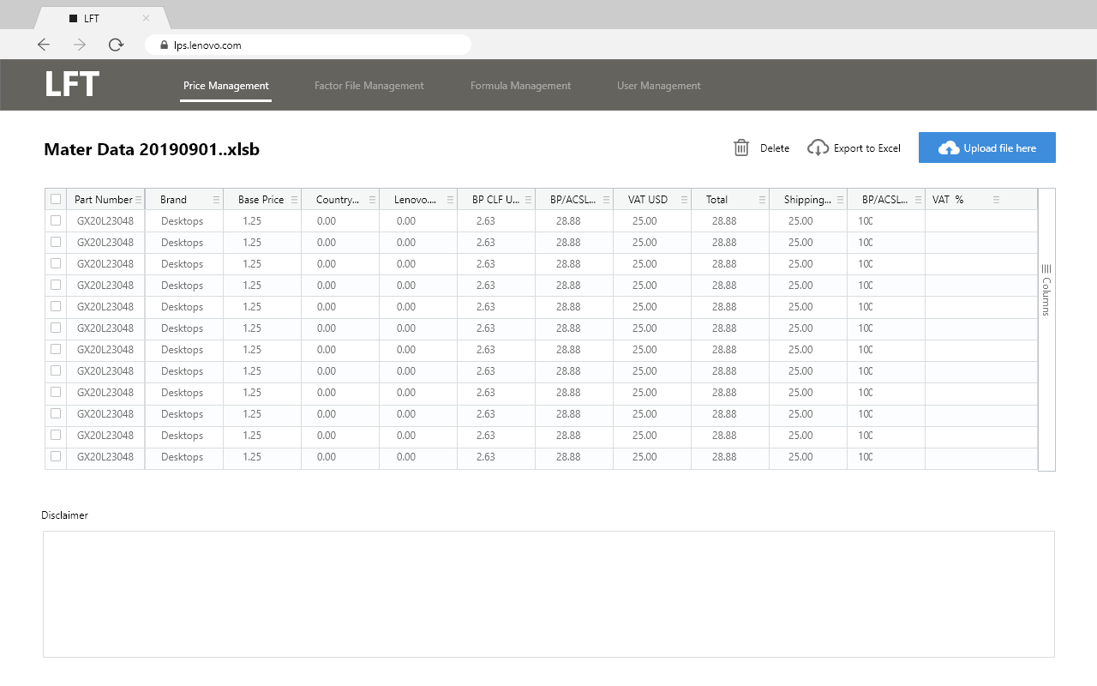
5. Calculate result
Display calculated result according to formula and upload file.
Export
Disclaimer section：
restrict disclaimer to Admin only

Slide 8
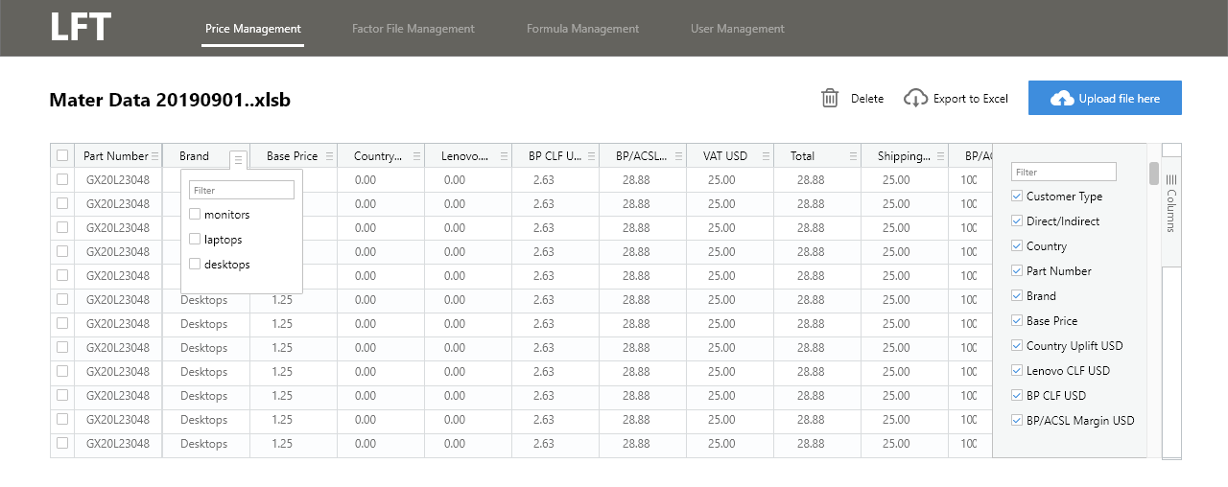
6. Customize Table
Filter menu
Click the button to open filter menu
Sorting
Click header name to sort the column
Drag Column
Drag header to anywhere you want
Hide/Display Column
Click the Columns to open the panel to select

Slide 9
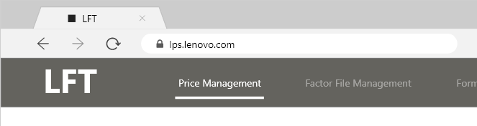
Change URL
Fit LFT address in LPS portal
URL

Slide 10
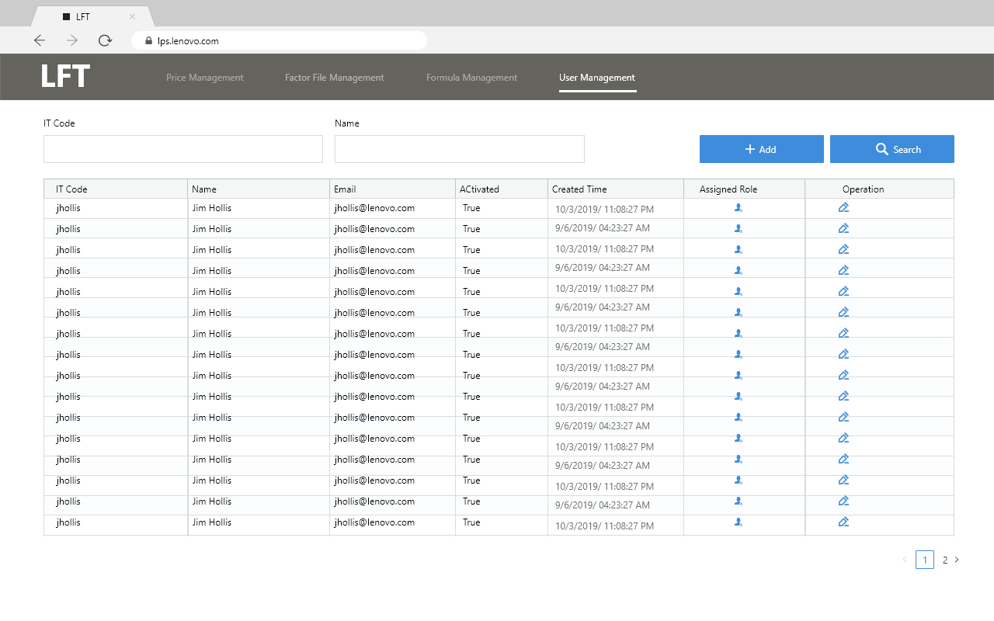
User Management

